Slide 1

Course8-“Voice”
Yahboom
Yahboom OMIBOX Tutorial

Slide 2
1
2
3
4
5
Learning
goals
Download
code
Experimental
phenomena
Preparation
程序编程
About code
Tencent
Yahboom OMIBOX Tutorial

Slide 3
1
Learning goals
1. The position of the Voice sensor on the robot car
2. Learn about the Arduino board pins connected to the Voice sensor of Omibox programmable robot
Yahboom OMIBOX Tutorial

Slide 4
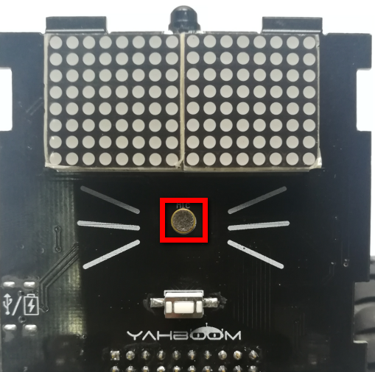
1
Preparation-1
As shown in the above picture, we circled the voice sensor with a red wire frame.
Yahboom OMIBOX Tutorial

Slide 5
1
Preparation-2
According to the hardware quick manual, we can see that the Voice sensor is connected to the A7 of the Arduino.
Yahboom OMIBOX Tutorial

Slide 6
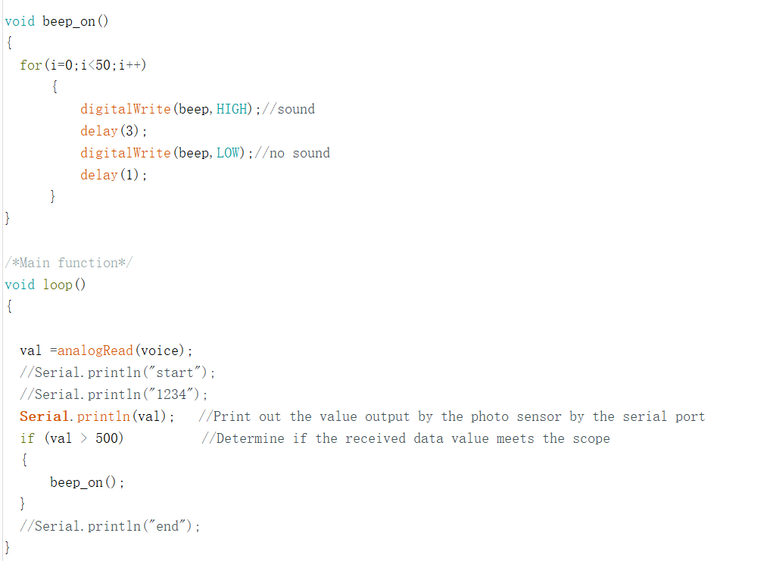
3
About code
The part code for this experiment is as follows:
Yahboom OMIBOX Tutorial

Slide 7


4
Download code
1.We need to open the code of this experiment: Voice.ino, click“√” under the menu bar to compile the code, and wait for the word "Done compiling " in the lower right corner, as shown in the figure below.
2. Click 【Tools】 --- 【Board】 -- we need to choose Arduino Uno. As shown in the figure below.
Yahboom OMIBOX Tutorial

Slide 8


4
Download code
3.In the menu bar of Arduino IDE, we need to select 【Tools】---【Port】--- selecting the port that the serial number displayed by the device manager, as shown in the figure below.
4. After the selection is completed, you need to click “ → ”under the menu bar to upload the code to the Arduino UNO board. When the word “Done uploading” appears in the lower left corner, the code has been successfully uploaded to the Arduino UNO board, as shown in the figure below.
Yahboom OMIBOX Tutorial

Slide 9
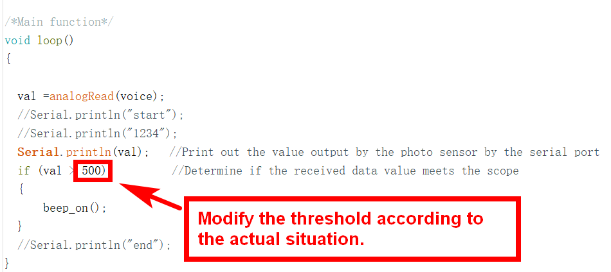
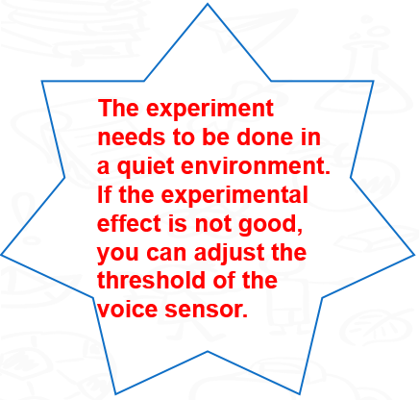
5
Experimental phenomena
After the program is uploaded, open the power of the car. When we take a breath at the sound sensor of the Omibox robot car, the buzzer will sound.
Yahboom OMIBOX Tutorial

Slide 10
Inspire Creativity Embrace Innovation
Thank you!!!
Yahboom

